Slide 1
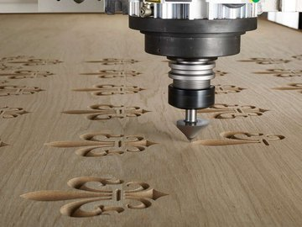
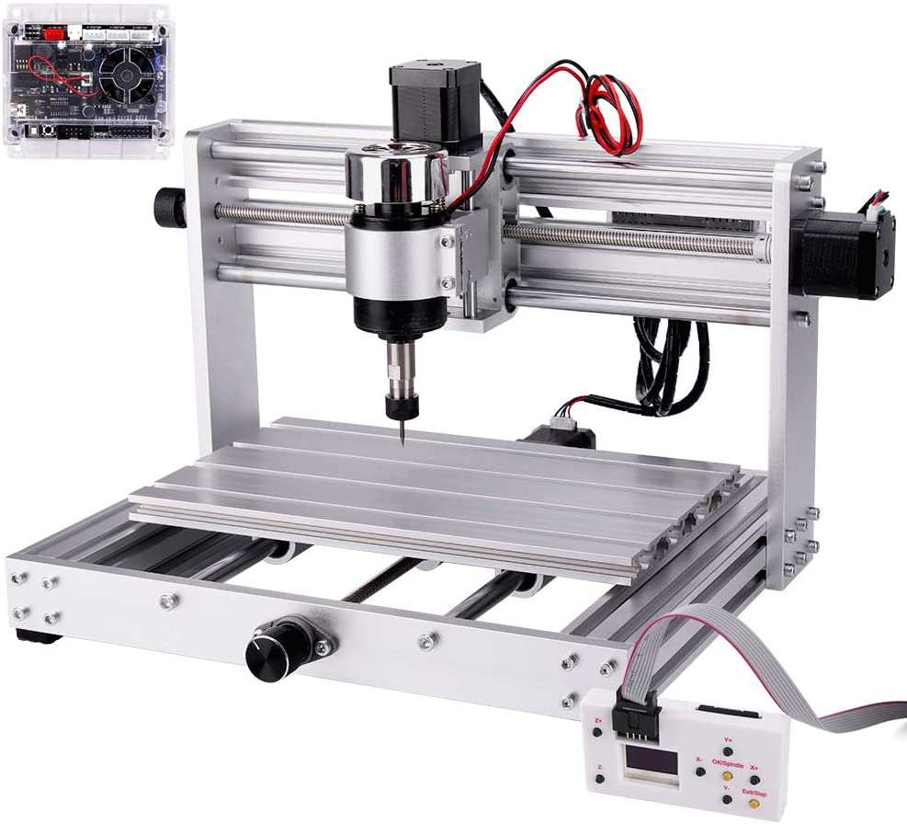
Team: Math.Random()
Improvement in controller interface for CNC Machines
Team members:
David Baker
Jean Louis
Edwin Marte
Kenneth Oyibo

Slide 2
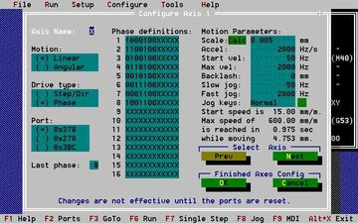
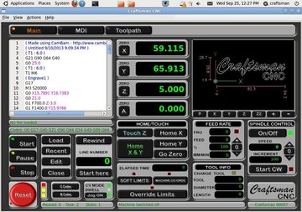
Define Problem
Too many options and too many buttons
Difficult to learn and master for beginners.
Safety issues for users responding when using a mouse.
Lack of emergency buttons
Lack of options for tactile interaction
Not tablet or mobile device options
Jogging options too difficult to control in PC
N. Muthupalaniappan, A. Maruthupandi, S. Pandian, A. J. P. Antony and S. R. Pandian, "A low-cost web-based learning platform for CNC machining education," 2014 Sixth International Conference on Advanced Computing (ICoAC), Chennai, 2014, pp. 91-96, doi: 10.1109/ICoAC.2014.7229753

Slide 3

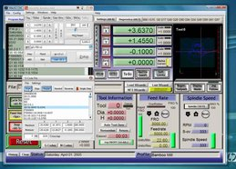
Jean Louis: User studies
Edwin Marte: Project team Coordinator
David Baker: User Experience
Kenneth Oyibo: User studies

Slide 4

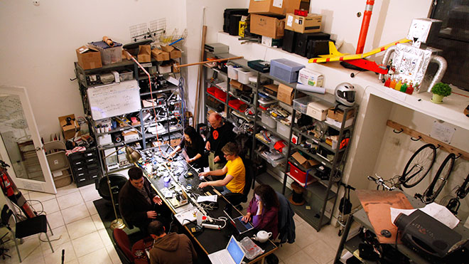
Who are you clients?
Makers-CNC owners
DIYers using CNC machines at Hackerspaces

Slide 5
What HCI concepts are applied?
Usability
Efficiency
Learnability
Memorability
Error
Satisfaction
Gestalt Principles​
Symmetry
proximity
Shneiderman’s Eight Golden Rules
Enable Frequent Users to use Shortcuts
Reduce Short-Term Memory Load
Fourcan Karim Mazumder and U Das. “Usability guidelines for usable
user interface”. In: International Journal of Research in Engineering and Technology 3.9 (2014), pp. 79–82.

Slide 6
What is your solution?
We are going to create an interface that connects with the GRBL open-source protocol to control a to CNC hardware/machine.
We are going to Address safety concerns in known interfaces.
Improve usability and increase novice users learning curve to master the CNC use

